Slide 1
Ethereum at BitGo
Securing and Running A Multisig Ethereum Wallet
Alex Melville
Notes:
Greet everyone, tell them how I met Prof. Boneh for lunch
How I was complaining to him about the problems with Ethereum
Lower level view of the crypto space than is usual (security, operational, programming workarounds.

Slide 2


Alex Melville (Technical Lead on the Coins Team)
github.com/Melvillian
Notes:
Growing up in Libertarian home, went to libertarian festivals when I was growing up. Heard about Bitcoin through this, then promptly forgot!
Best interview with BitGo, working there ever since.
Now I’m the technical lead of the Coins team at BitGo, we deal with researching new coins, staying abreast of crypto developments, and in general working on the cryptocurrency-related aspects of BitGo

Slide 3
Today’s Plan
Questions!
Notes:
I’m here to talk about Ethereum, but I’m most excited to be here to answer your questions
Open forum discussion
Ask questions to them now, how many have own some Ethereum or Bitcoin? How many have written an app for Ethereum? How many have tried to run an Ethereum full node (parity, geth?)

Slide 4


BitGo: 2-of-3 Multi-Signature Wallets
No single point of failure!
CUSTOMER KEY
BITGO KEY
EMERGENCY (BACKUP) KEY
Notes:
No single point of failure
Go through the 3 keys and why they exist
Talk about who our customers are

Slide 5
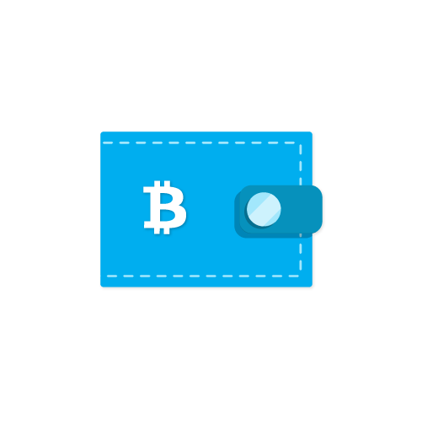
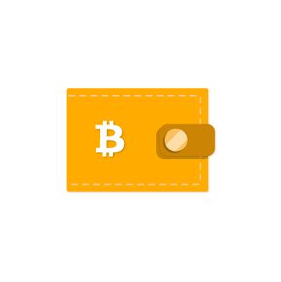
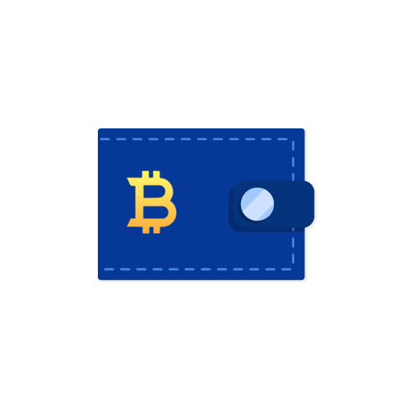
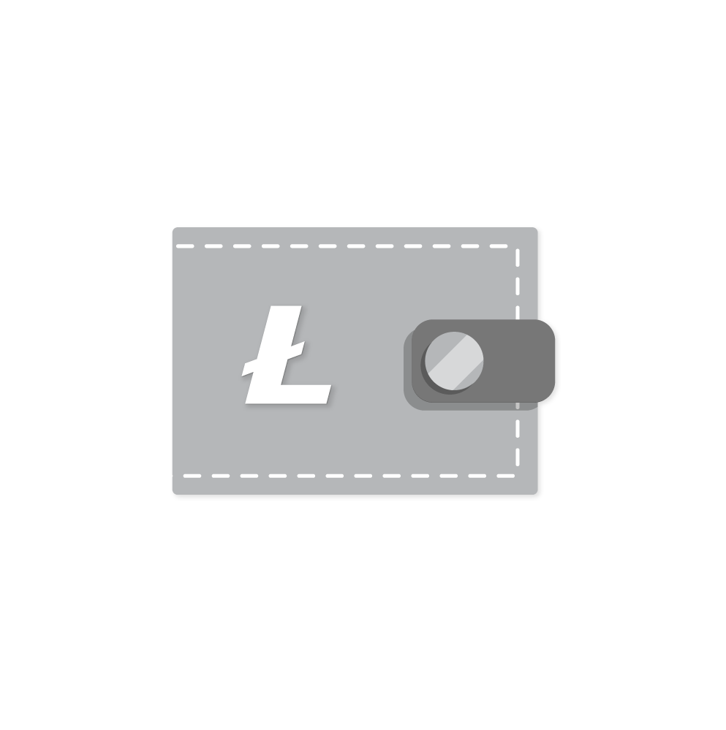
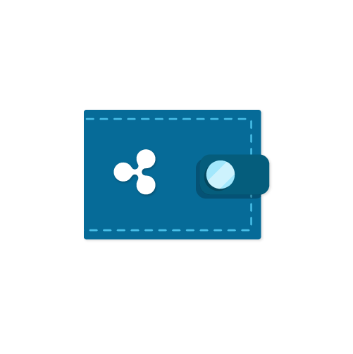
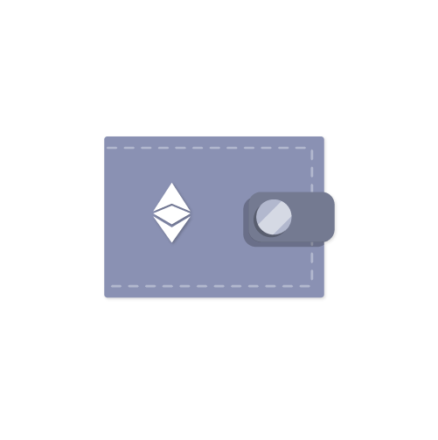
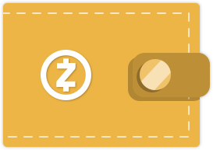




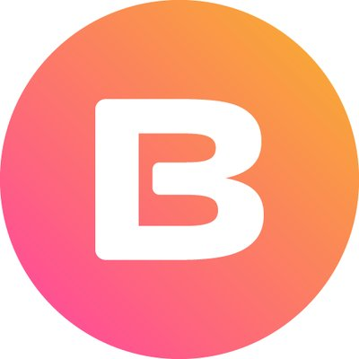






















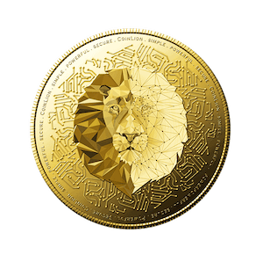


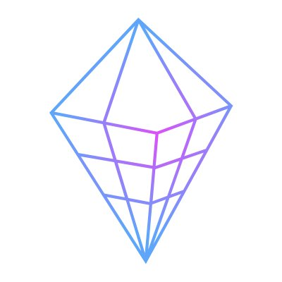

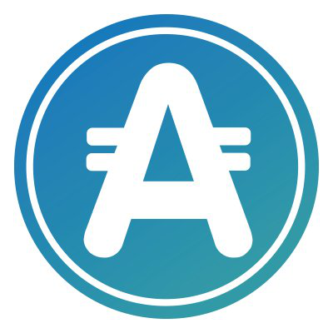











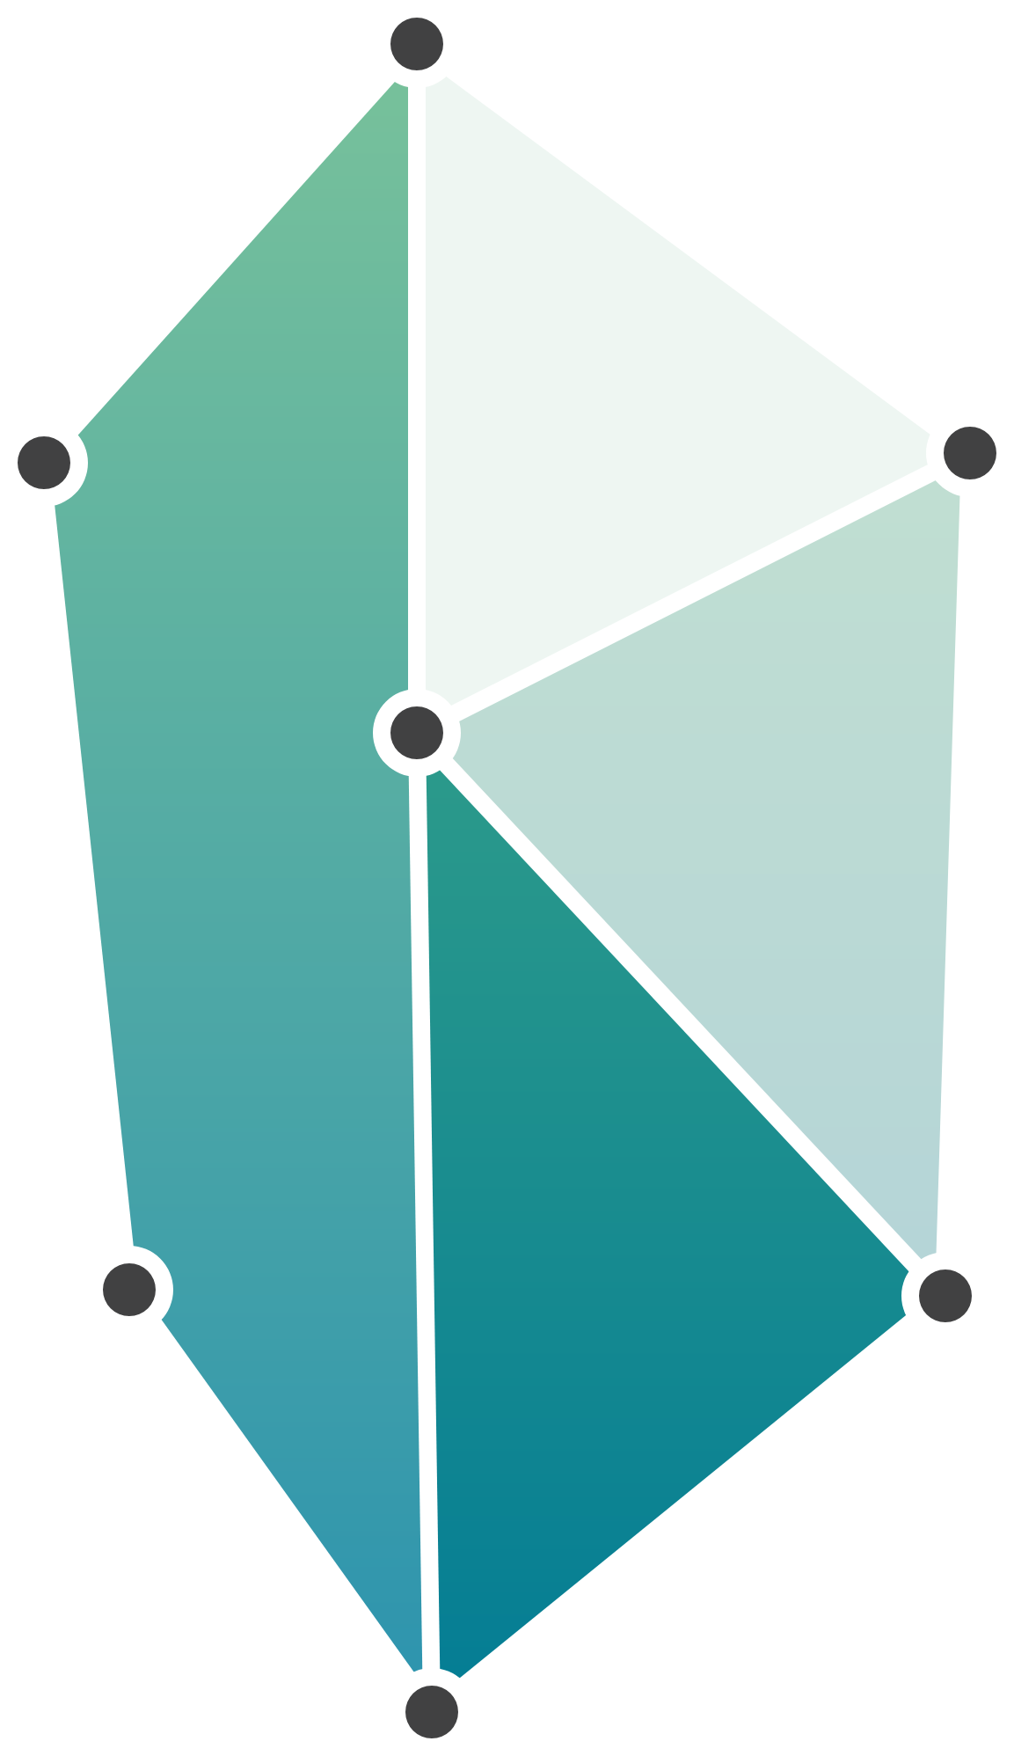






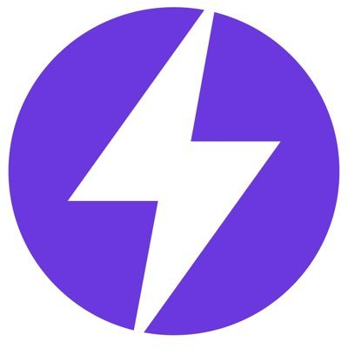




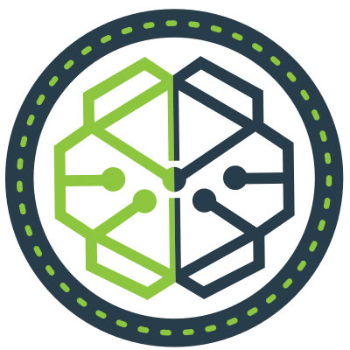
Supported Coins and Tokens
BITCOIN
BITCOIN CASH
BITCOIN GOLD
LITECOIN
ZCASH
XRP
DASH
STELLAR
ETHEREUM
BTC
BCH
BTG
LTC
ZEC
XRP
DASH
XLM
ETH
0x (ZRX)
Bread (BRD)
Gemini Dollar (GUSD)
Numeraire (NMR)
Rebglo (REB)
TrueUSD (TUSD)
Aelf (ELF)
Celsius (CEL)
Gnosis (GNO)
OmiseGo (OMG)
Rialto (XRL)
WaltonChain (WTC)
AION (AION)
Change (CAG)
Golem (GNT)
OPTin Token (OPT)
Salt (SALT)
WeTrust (TRST)
AirSwap (AST)
Civic (CVC)
Hold (HOLD)
Paxos (PAX)
Sentinel Protocol (UPP)
Worldwide Asset eXchange (WAX)
ANA (ANA)
CoinLion (LION)
Indorse (IND)
PlusCoin (PLC)
Serenity (SRNT)
Zilliqa (ZIL)
AppCoins (APPC)
Colu Local Network (CLN)
iShook (SHK)
Polymath (POLY)
Snovio (SNOV)
Aragon (ANT)
Cryptopay (CPAY)
Kin (KIN)
Populous (PPT)
Status Network Token (SNT)
...with more being added all the time.
Augur (REP)
DAOstack (GEN)
Kyber Network (KNC)
Power Ledger (POWR)
Storj (STORJ)
Bancor (BNT)
Decision Token (HST)
Linker Coin (LNC)
Propy (PRO)
Storm (STORM)
Basic Attention Token (BAT)
Dent (DENT)
Maker (MKR)
Pundi X (NPXS)
SwissBorg (CHSB)
Notes:
Support 9 coins, and many ERC20 tokens

Slide 6
Ethereum Basics (Addresses vs. Contracts)
Addresses:
Basically like Bitcoin Addresses
Single Signature
Initiate Contract Creation/Execution
Pay for Fees! (EIP 101)
Contracts
Turing-Complete Execution
Extremely Tricky to Reason About
External (Fee) Address
TX
Creation
10
Notes:
they’ve seen this before. Read this slide quickly

Slide 7


Ethereum Basics (Two Full Node Implementations)
Parity
Geth
Rust
Golang
Notes:
This let’s them move independently and work on separate things (ewasm, proof of authority)
But also means that bugs are more likely, and when they do happen, less likely to hardfork
Conway’s Law

Slide 8
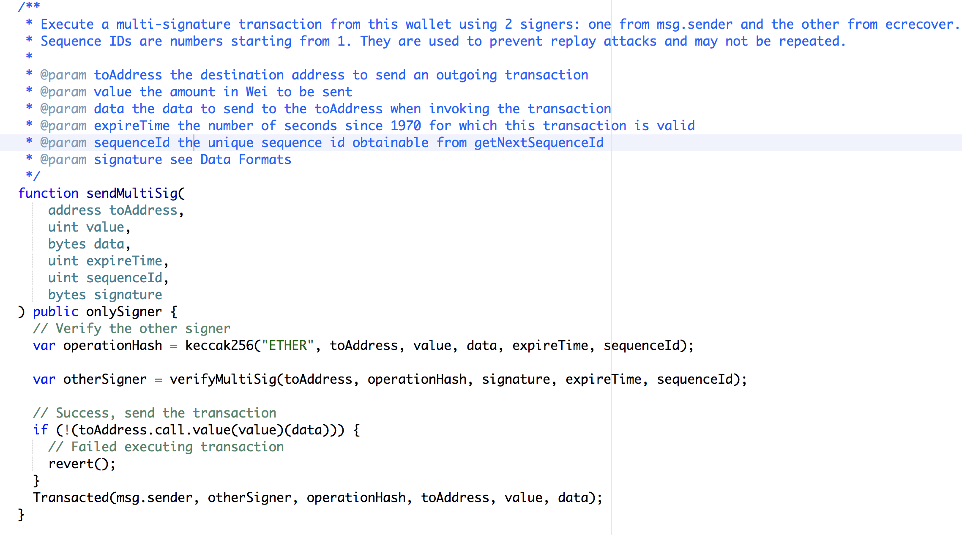
Writing and Deploying A Multisig Wallet Smart Contract
The Code:
Multisignature Wallet
12 functions
Sending
Safe Mode
Helper Functions
Events
Transacted
Deposited
web3.js (we don’t use it!)
Notes:
Explain how our multisig works
Explain events
Talk about web3.js, and why we don’t use it because it doesn’t fit with our indexer model

Slide 9
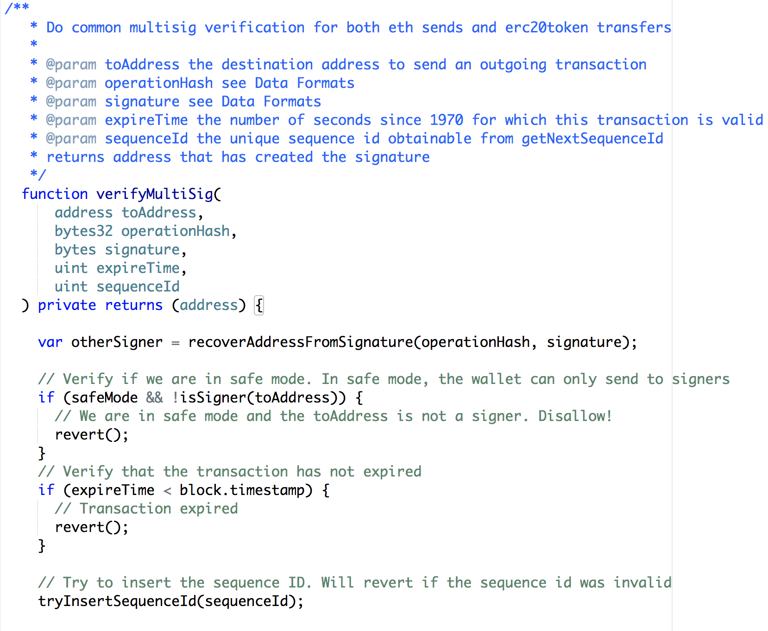
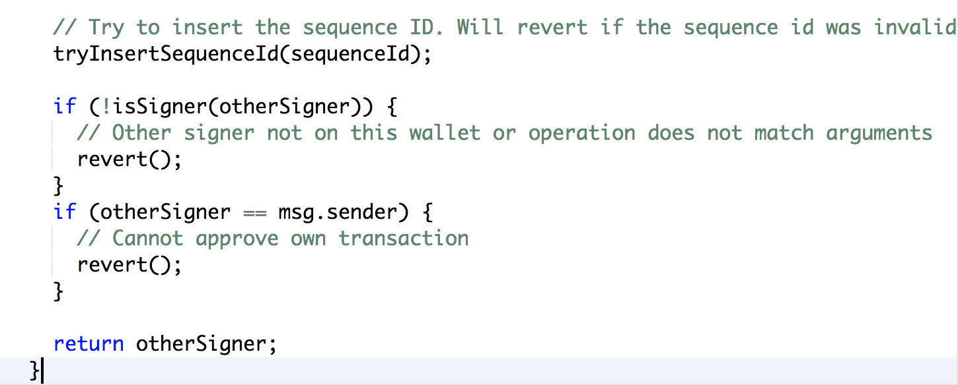
Writing and Deploying A Multisig Wallet Smart Contract

Slide 10
Writing and Deploying A Multisig Wallet Smart Contract
The Deploy:
Similar Care as Hardware
Audits
OpenZeppelin
Coinspect
ABDK Consulting
Fee Address
It Costs to Deploy Wallet and Receive Addresses
25
Notes:
Read bullet points

Slide 11

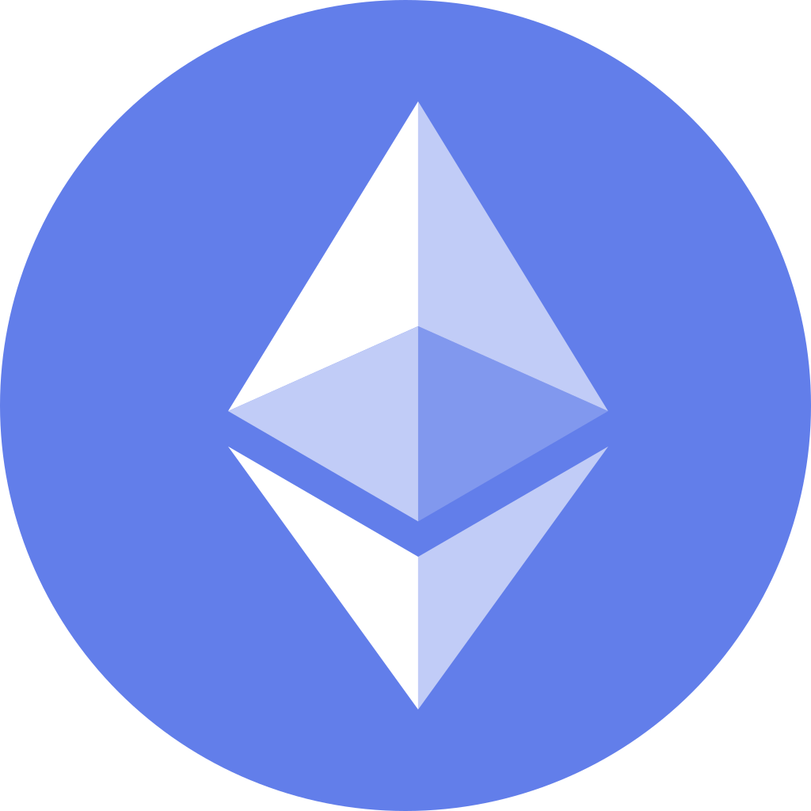


The Ethereum Multisig Problem: Fungibility and Usability
TX
HitBTC does not see the transaction!
Notes:
A

Slide 12
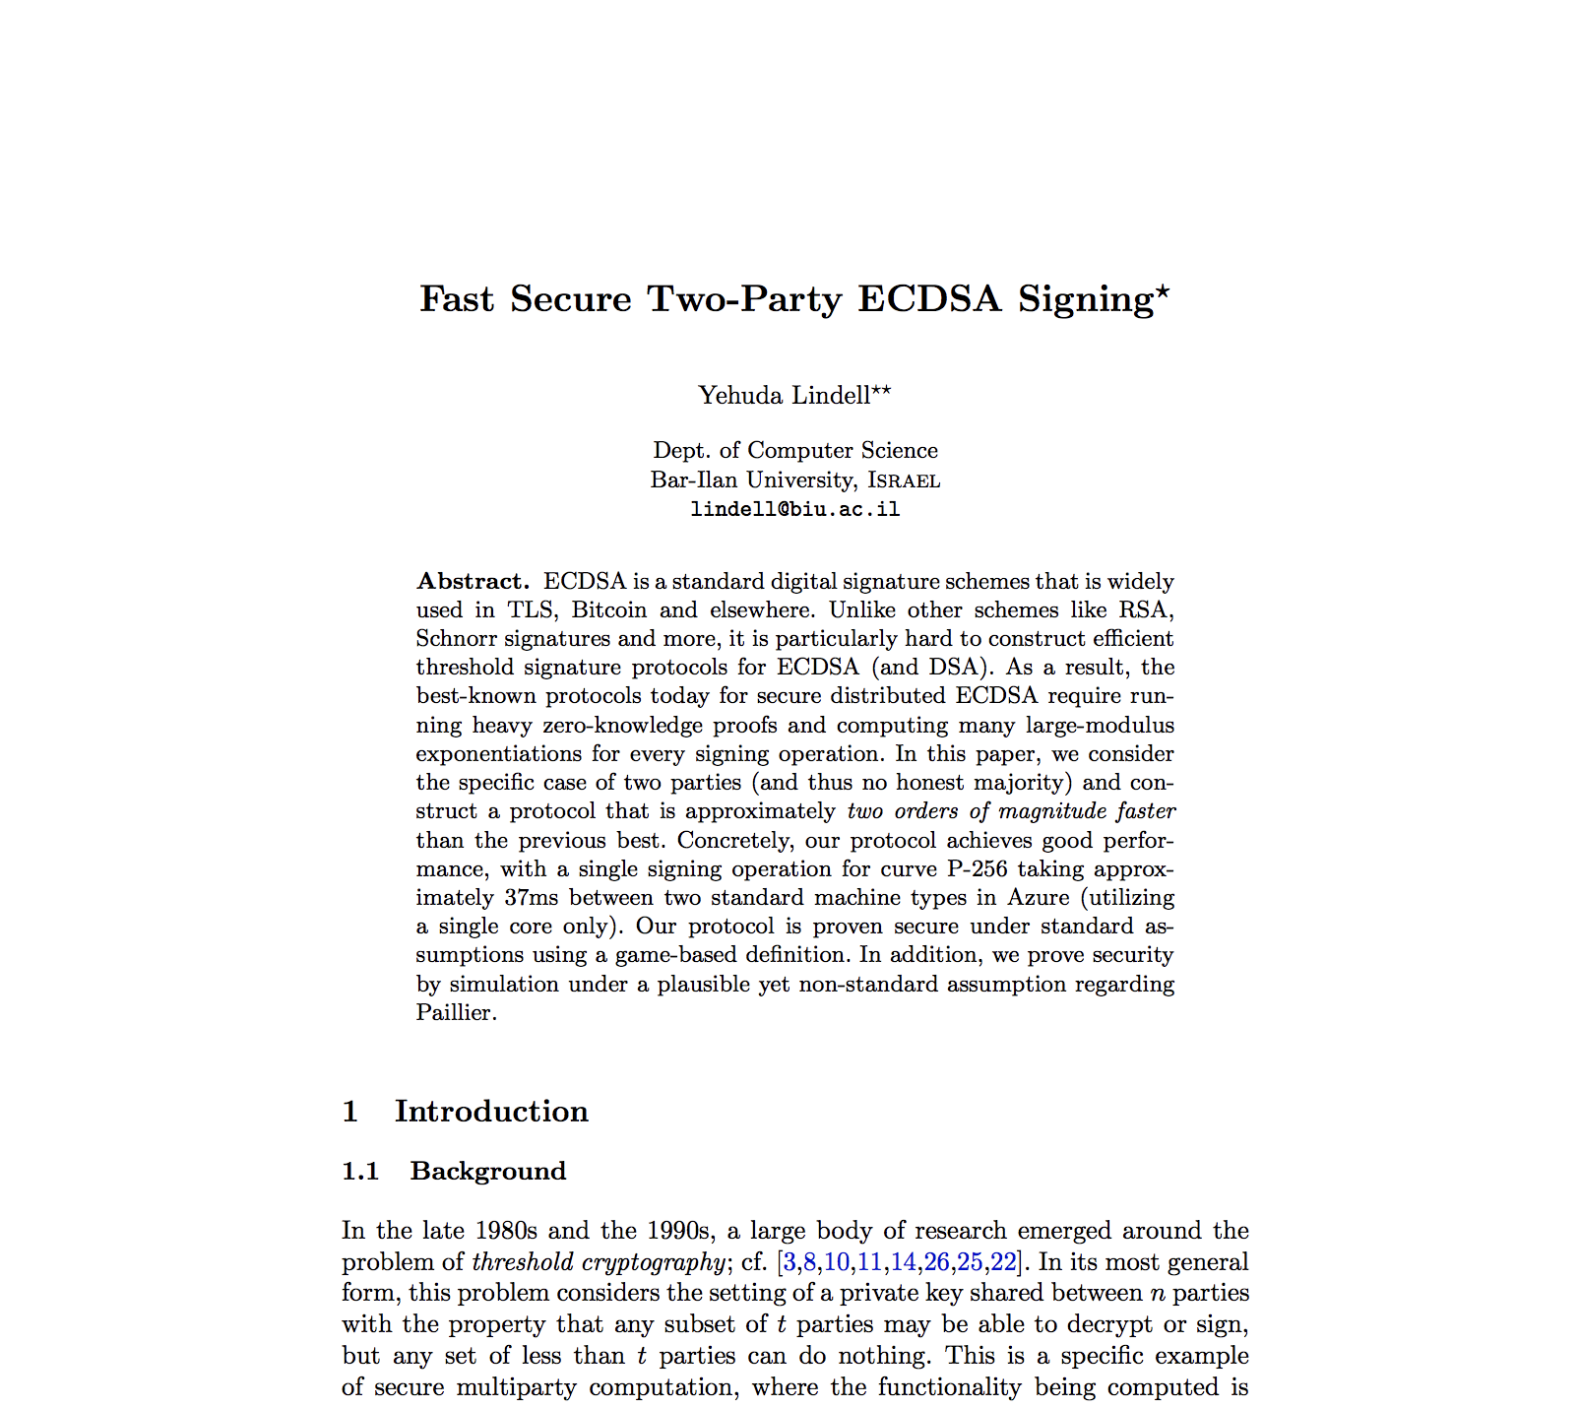
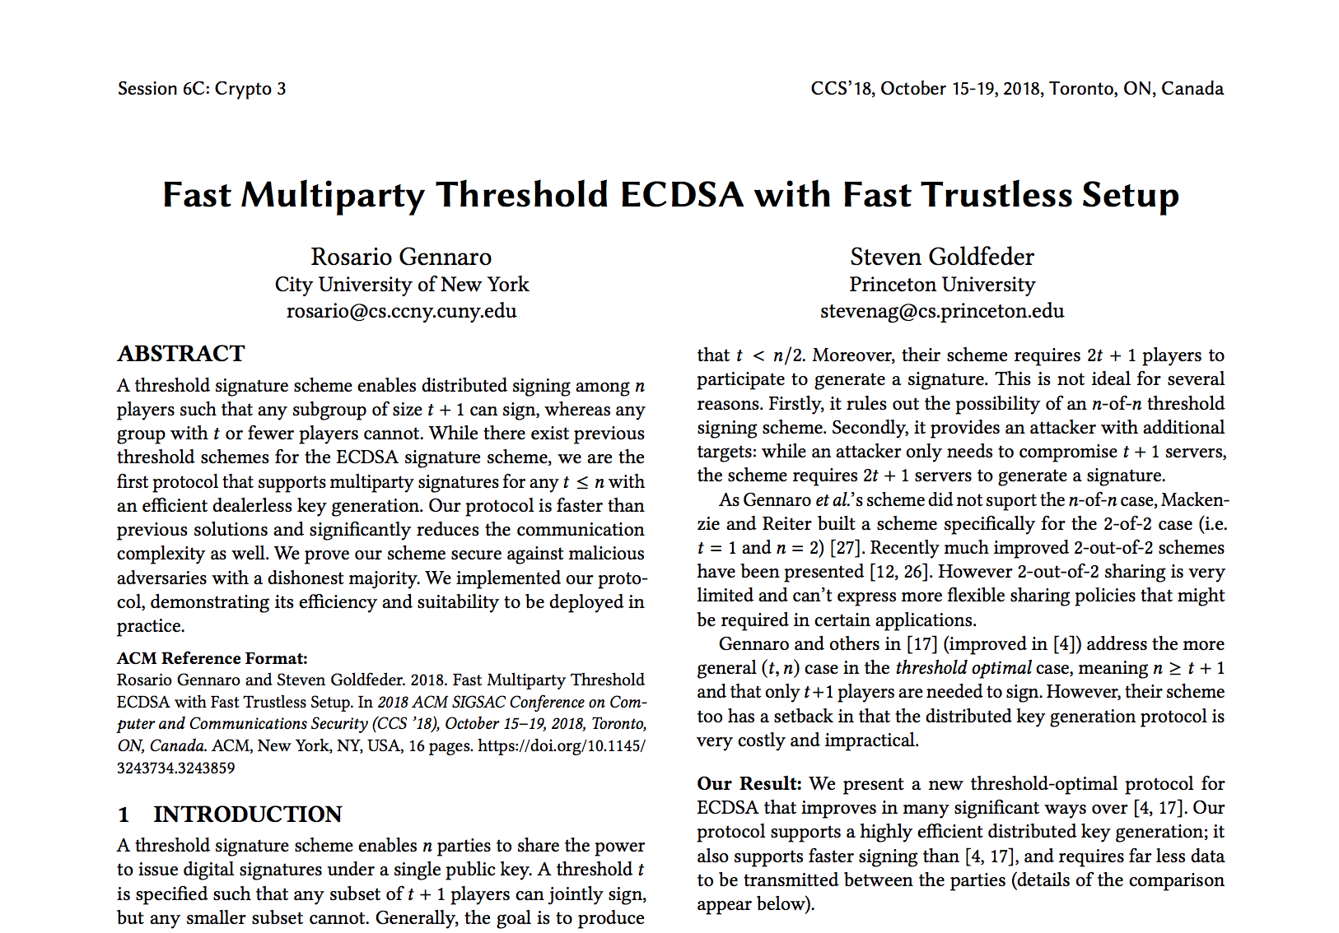
The Ethereum Multisig Problem
Multiparty ECDSA Signatures to the Rescue!
45
Notes:
Introduce single-sig multiparty ECDSA signatures as a way forward
Point out Prof. Boneh, and how he’s working on Pairing schemes for Multiparty ECDSA
Maybe one of you will be the one’s to save Ethereum from this thorny problem!

Slide 13
Transaction Nonce Holes: Full Node
TX #1
1 ETH
TX #2
3 ETH
TX #3
5 ETH
TX #4
7 ETH
1
2
3
4
= Confirmed

Slide 14
Transaction Nonce Holes: Full Node
TX #1
1 ETH
TX #2
3 ETH
TX #3
5 ETH
TX #4
7 ETH
1
2
3
4
5
TX #5
9 ETH
= Unconfirmed
= DB Query
= Confirmed

Slide 15
Transaction Nonce Holes: Full Node
TX #1
1 ETH
TX #2
3 ETH
TX #3
5 ETH
TX #4
7 ETH
1
2
3
4
5
TX #5
9 ETH
TX #6
11 ETH
= Unconfirmed
= DB Query
= Confirmed

Slide 16
Transaction Nonce Holes: Full Node
TX #1
1 ETH
TX #2
3 ETH
TX #3
5 ETH
TX #4
7 ETH
1
2
3
4
5
TX #5
9 ETH
TX #6
11 ETH
= Unconfirmed
= DB Query
= Confirmed

Slide 17
Transaction Nonce Holes: Database
DB
5
1
2
3
4
5
= Unconfirmed
= DB Query
= Confirmed

Slide 18
Transaction Nonce Holes: Database
DB
5
1
2
3
4
5
= Unconfirmed
= DB Query
= Confirmed

Slide 19
Transaction Nonce Holes: Database
DB
6
1
2
3
4
5
6
= Unconfirmed
= DB Query
= Confirmed

Slide 20
Transaction Nonce Holes: Database
DB
6
1
2
3
4
5
6
= Unconfirmed
= DB Query
= Confirmed

Slide 21
Transaction Nonce Holes: Database
DB
8
1
2
3
4
5
6
7
8
= Unconfirmed
= DB Query
= Confirmed

Slide 22
Transaction Nonce Holes: Database
DB
8
1
2
3
4
5
7
8
= DB Query
= Nonce Confirmed

Slide 23
Transaction Nonce Holes: Database
TX #9
1 ETH
DB
8
1
2
3
4
5
7
8
= Unconfirmed
= DB Query
= Confirmed

Slide 24
Transaction Nonce Holes: Database
DB
8
1
2
3
4
5
6
7
8
= Unconfirmed
= DB Query
= Confirmed

Slide 25
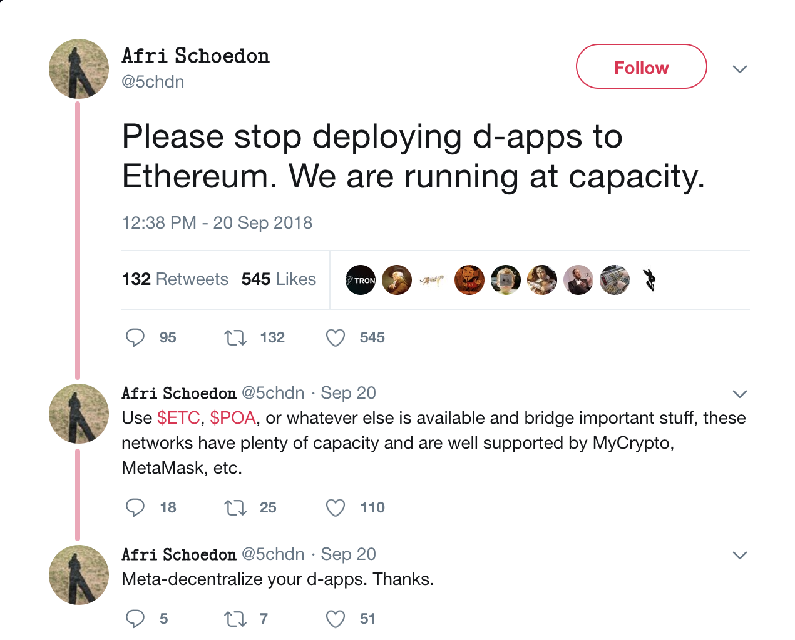
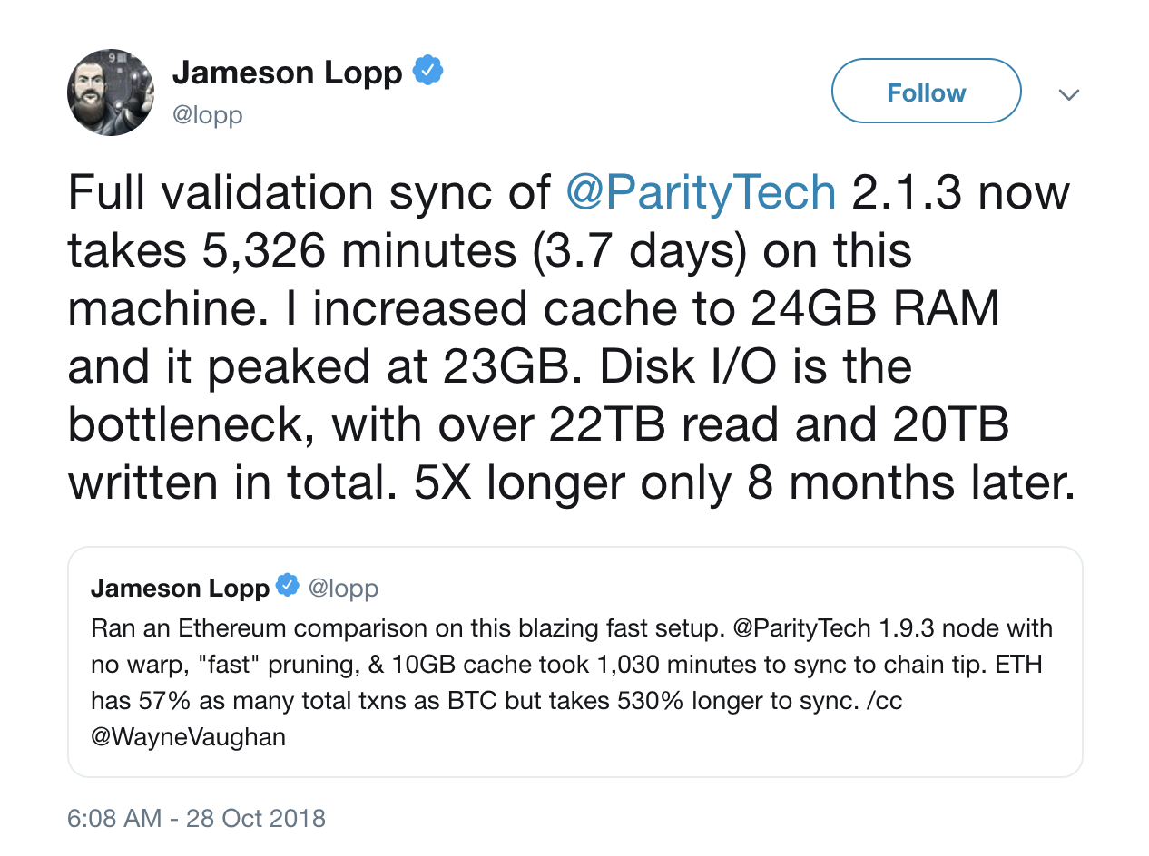
Learning to Love/Hate Parity
60
Notes:
The different types of syncing of ethereum
The IO attacks starting at 2.7 million blocks
broadcast problems
In order to run ethereum correctly, you must restart it whenever you detect a problem

Slide 26
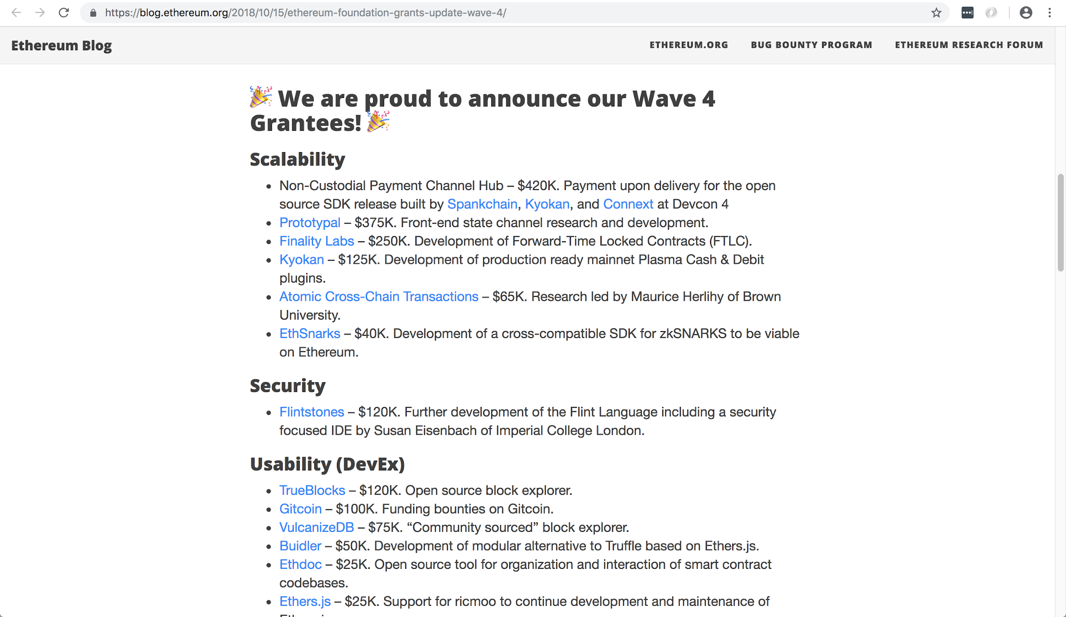
Right At Your Fingertips

Slide 27
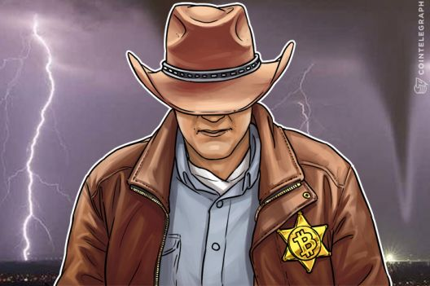
Thank You!

